Slide 1
18PYB103J
SEMICONDUCTOR PHYSICS
MODULE 4
LECTURE 8 – Extraction Parameters
I-V Characteristic of PN Junction Diode

Slide 2
PN Junction Diode
P-N junction is one of the basic building blocks of integrated circuits. Such a junction can be formed by selective diffusion or ion implantation of n-type or p-type dopant to the p-type or n-type semiconductor.
When p-region and n-region are brought in close contact a p-n junction forms due to the diffusion of charge carriers. While, holes diffuse from p region to n region, electrons diffuse from n region to p region.

Slide 3
PN Junction Diode
Under thermal equilibrium a built in electric field directed from positive to negative charge which gives rise to drift current and no net transport of carriers due to diffusion is observed across the potential barrier(also called as depletion region).
At thermal equilibrium, drift and diffusion component of current must cancel each other, J_{n} and J_{p} is zero. Hence the Fermi level must be constant throughout and the electron and hole concentrations on both sides remain same.

Slide 4
PN Junction Diode
While in thermal equilibrium no external voltage is applied between the n-type and p-type material, there is an internal potential, φ_{i}, which is caused by the work function difference between the n-type and p-type semiconductors. This potential equals the built-in potential.

Slide 5
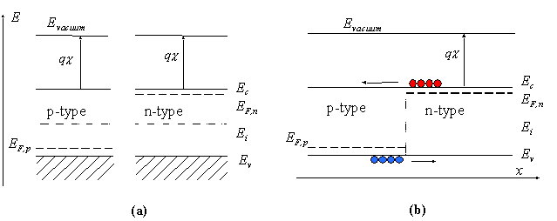
ENERGY BAND DIAGRAM
Flatband diagram
Energy band diagram of a p-n junction (a) before and (b) after merging the n-type and p-type regions

Slide 6
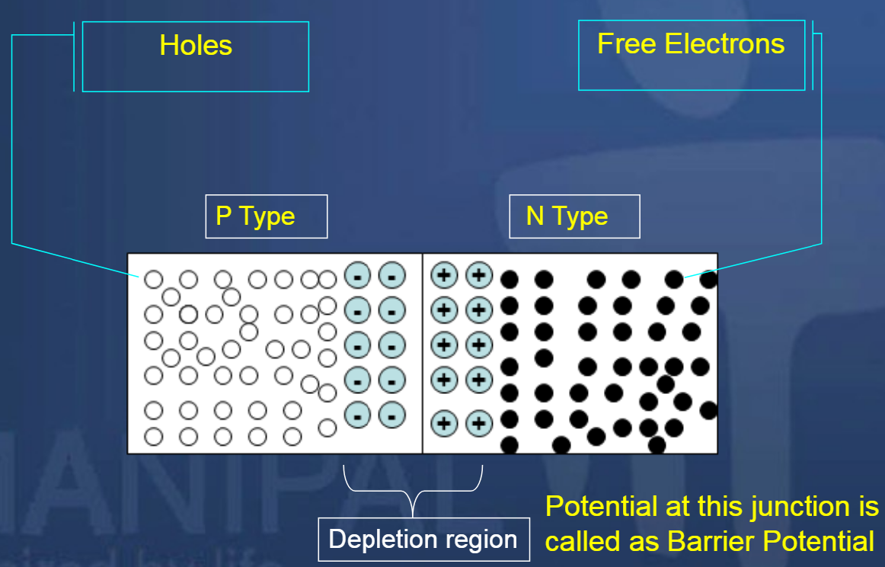
PN Junction Diode

Slide 7
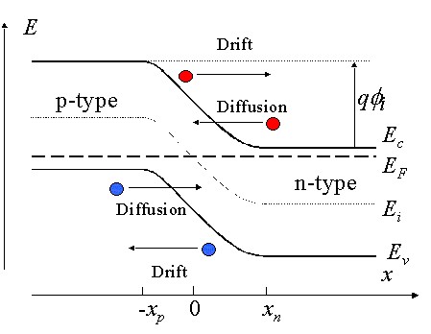
PN Junction Diode

Slide 8
Forward Biasing of PN – Junction Diode
Forward biasing the p-n junction drives holes to the junction from the p-type material and electrons to the junction from the n-type material.
At the junction the electrons and holes combine so that a continuous current can be maintained.

Slide 9
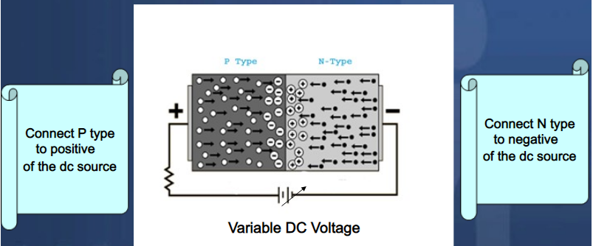
Forward Biasing of PN – Junction Diode

Slide 10
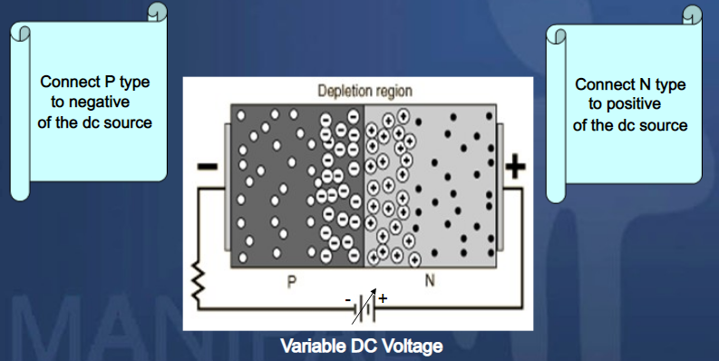
Reverse Biasing of PN – Junction Diode

Slide 11
Reverse Biasing of PN – Junction Diode
The application of a reverse voltage to the p-n junction will cause a transient current to flow as both electrons and holes are pulled away from the junction.
When the potential formed by the widened depletion layer equals the applied voltage, the current will cease except for the small thermal current.

Slide 12
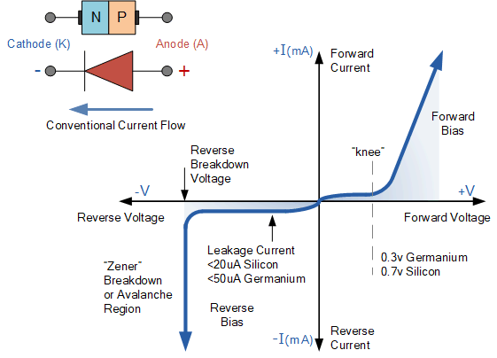
I-V Characteristics in a Diode

Slide 13


